Slide 1
TCP/IP Network Fundamentals
UEEN2013/UEEN2432
(Topic 06)
Internet Protocol version 6 (IPv6)

Slide 2
IPv6 motivation
The architecture of IPv6 has been designed to allow existing IPv4 users to transition easily to IPv6 while
providing services such as end-to-end security, quality of service (QoS),
providing globally unique addresses.
providing larger IPv6 address space allows networks to scale and provide global reachability.
simplified IPv6 packet header format handles packets more efficiently.

Slide 3
IPv6 Strengths
Larger Addresses
Allows billions of devices to be interconnected
Especially mobile devices

Slide 4
IPv6 Strengths
Larger Address pool means no NAT in future deployment scenarios
Eliminate NAT architectures as a means of address scaling
Improve the potential for use of end-to-end security tools for encryption and authentication
the flexibility of the IPv6 address space reduces the need for private addresses
Allow for widespread deployment peer-to-peer applications
No NATS
Regain fundamental leverage of IP as a network architecture
Simple interior service requirement
Service environment defined as end-to-end application
This is a VERY GOOD THING
Complex network architectures scale very poorly!
Simple architectures will service a Giganet

Slide 5
IPv6 Address & Subnet Rules

Slide 6
Some Terminology
node a protocol module that implements IPv6
router a node that forwards IPv6 packets not explicitly addressed to itself
host any node that is not a router
link a communication facility or medium over which nodes can communicate at the link layer, i.e., the layer immediately below IPv6
neighbors nodes attached to the same link
interface a node’s attachment to a link
address an IPv6-layer identifier for an interface or a set of interfaces

Slide 7
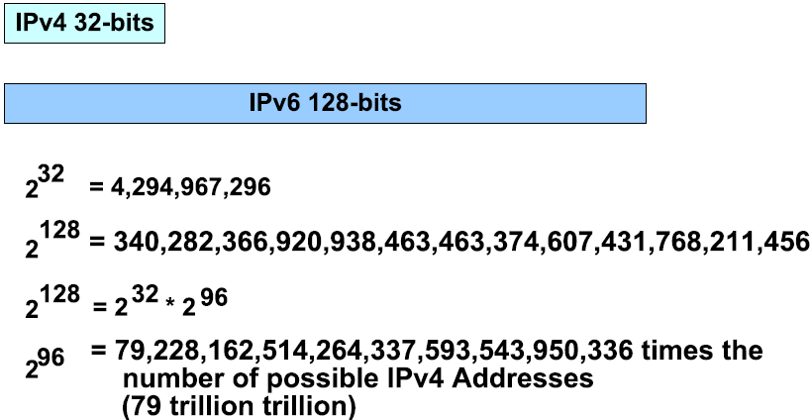
IPv6 Rule #1
IPv6 address is designed to be 128 bits long.

Slide 8
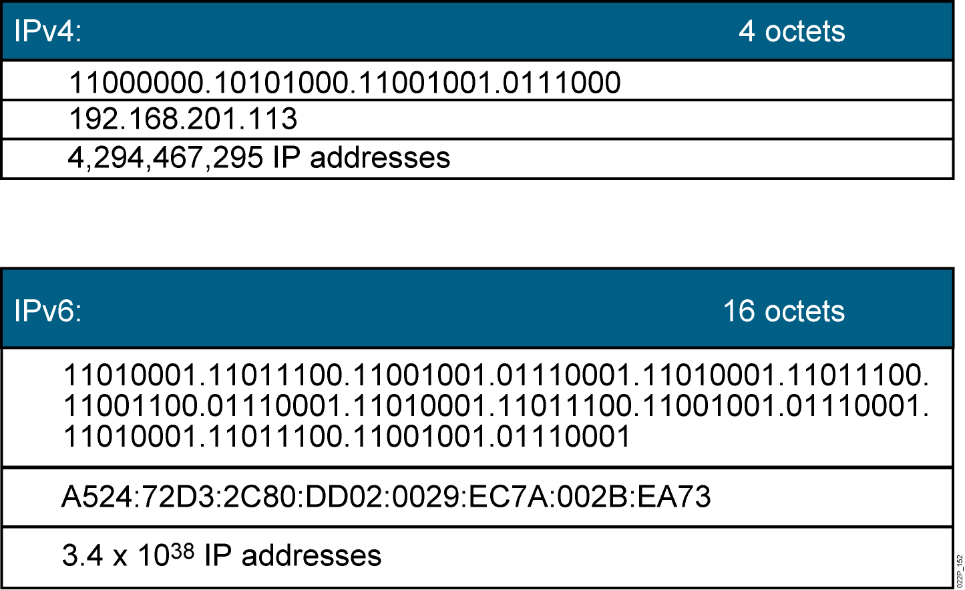
Comparison of IPv4 and IPv6
Currently, there are approximately 1.3 billion usable IPv4 addresses available.
Notes:
The IPv4 address space provides approximately 4.3 billion addresses. Of that address space, approximately 3.7 billion addresses are actually assignable; the other addresses are reserved for special purposes such as multicasting, private address space, loopback testing, and research. Based on figures as of January 1, 2007, about 2.4 billion of these available addresses are currently assigned to either end users or Internet service providers (ISPs). That leaves roughly 1.3 billion addresses still available from the IPv4 address space.
An IPv6 address is a 128-bit binary value, which can be displayed as 32 hexadecimal digits, as shown in the figure. It provides 3.4 times 10 to the 38th IP addresses. This version of IP addressing should provide sufficient addresses for future Internet growth needs.
In addition to its technical and business potential, IPv6 offers a virtually unlimited supply of IP addresses. Because of its generous 128-bit address space, IPv6 generates a virtually unlimited stock of addresses—enough to allocate more than the entire IPv4 Internet address space to everyone on the planet.

Slide 9
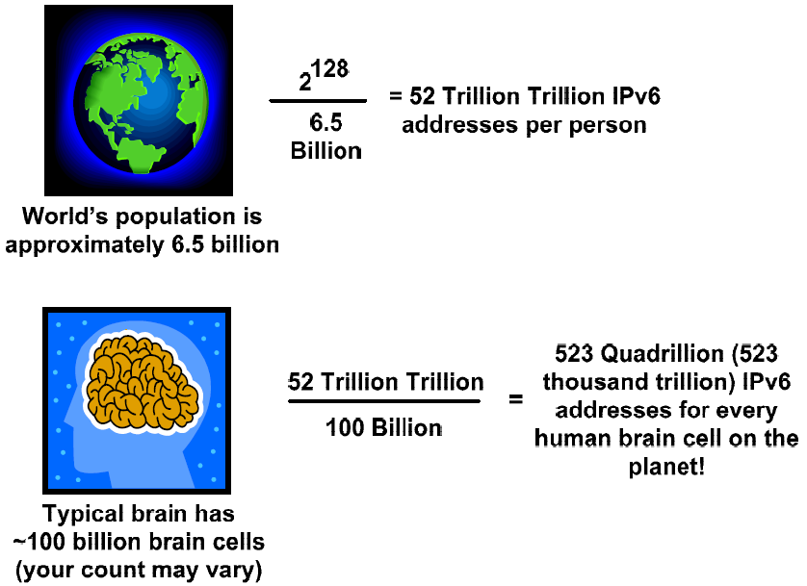
Amount of IPv6 Address
6.7 x 10²³ Addresses / m² on the earth

Slide 10
IPv6 Rule #2
2001:0DA8:E800:0000:0260:3EFF:FE47:0001
IPv6 address format is represented in 32 hexadecimal numbers
IPv6 addresses are represented as a series of 16-bit hexadecimal fields separated by colons (:) in the format: x:x:x:x:x:x:x:x.
Each hexadecimal is 4 bits
128 bits = 4 bits (1 hex digit) x 32
Written in 8 groups of 4 hexadecimal digits
Each group represents 16 bits
Separator is “:”

Slide 11
IPv6 Rule #3
Two ways that an IPv6 address may be represented in a more abbreviated form.
However, the rule of IPv6 abbreviation only applies to string of zeros
First, leading zeros in each 16-bit field may be omitted.
2001:0000:0001:0002:0000:0000:0000:ABCD => 2001:0:1:2:0:0:0:ABCD
Leading zeros in a field are optional, so 09C0 = 9C0 and 0000 = 0.
One can NOT abbreviate the trailing zeros: 2001::1200:0:1

Slide 12
IPv6 Rule #3
Secondly, once and only once, in an address, sequential zeros can be replaced with a pair of colons (::)
2001:0:0:2:0:0:0:ABCD => 2001:0:1:2::ABCD
Successive fields of zeros can be represented as “::” only once in an address.
Using the “::” notation greatly reduces the size of most addresses. For example, FF01:0:0:0:0:0:0:1 becomes FF01::1.
Not valid!! 2001::123:A::2 (:: appear twice)
::1 = loopback address
:: = unspecified address

Slide 13
Example of IPv6 Abbreviation
2001:0DA8:E800:0000:0260:3EFF:FE47:0001
2001:0DA8:E800:0000:0260:3EFF:FE47:0001
2001:DA8:E800:0:260:3EFF:FE47:1
2001:0DA8:E800:0000:0000:0000:0000:0001
2001:0DA8:E800:0000:0000:0000:0000:0001
2001:DA8:E800::1

Slide 14
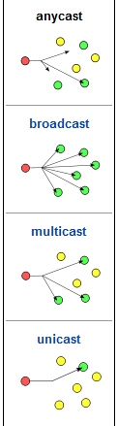
IPv6 Rule #4
IPv6 supports three types of addresses:
Unicast—for sending to a single interface.
Multicast—for sending to all of the interfaces in a group or multiple interfaces.
Anycast—for sending to the nearest interface in a group.
IPV6 does not support broadcast address.

Slide 15
IPv6 Address Types
Unicast
Address is for a single interface.
One-to-one delivery to single interface.
IPv6 has several types (for example, global, reserved, and link-local).
Multicast
One-to-many.
Enables more efficient use of the network.
Uses a larger address range.
Anycast
One-to-nearest (allocated from unicast address space).
Multiple devices share the same address.
All anycast nodes should provide uniform service (e.g DNS).
Source devices send packets to anycast address.
Routers decide on closest device to reach that destination.

Slide 16
IPv6 Unicast Address
A unicast address identifies a single device.
Work similarly as IPv4 class A, B, C addresses
A packet sent to a unicast address is delivered to the interface identified by that address.
All interfaces are required to have at least one link-local unicast address.
There are a few types of IPv6 unicast addresses

Slide 17
IPv6 Multicast Address
IPv6 broadcasts are replaced by multicast addresses.
A packet sent to a multicast address is delivered to all interfaces identified by the multicast address.
Multicast enables efficient network operation by using functionally specific multicast groups to send requests to a limited number of computers on the network.
IPv6 multicast address work similarly as IPv4 multicast address.
The range of multicast addresses in IPv6 is larger than in IPv4.

Slide 18
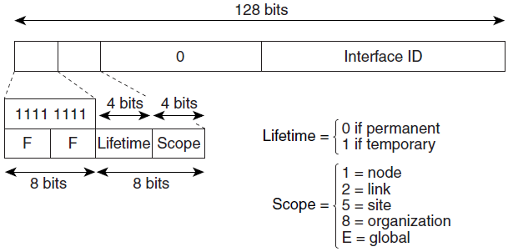
IPv6 Multicast Address
A permanent multicast address has a lifetime parameter equal to 0; a temporary multicast address has a lifetime parameter equal to 1.
A multicast address that has the scope of a node, link, site, or organization, or a global scope has a scope parameter of 1, 2, 5, 8, or E, respectively.
For example, a multicast address with the prefix FF02::/16 is a permanent multicast address with a link scope.

Slide 19
Anycast Address
An anycast address identifies a list of devices or nodes; therefore, an anycast address identifies multiple interfaces.
An IPv6 address that will be used more than once (or used on 2 or more devices).
A packet sent to an anycast address is delivered to the closest interface, as defined by the routing protocols in use.
Route to the closest network, depending on the routing metric.
Anycast addresses are syntactically indistinguishable from global unicast addresses, because anycast addresses are allocated from the global unicast address space.
Anycast addresses cannot be used as the source address of an IPv6 packet.

Slide 20
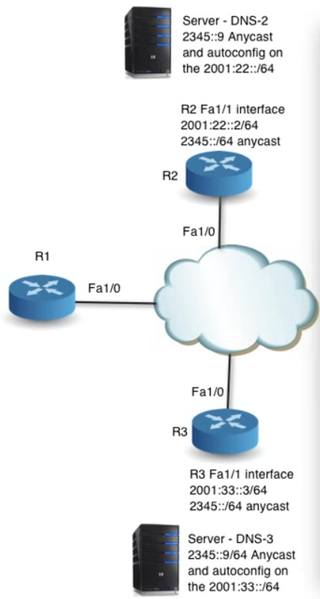
Example of Anycast Usage
Two DNS server having the same IPv6 “anycast” address.
DNS-2 and DNS-3
2345::9
If R1 wants to access the DNS, it just type 2345::9.
Depending on the “nearest” route, R1 will access either 1 of the DNS server.

Slide 21
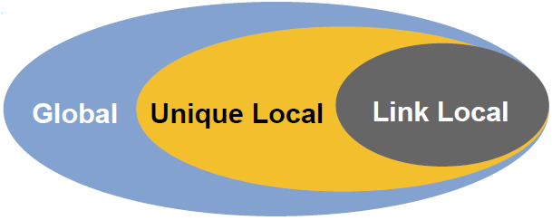
IPv6 Subnet Rule #5
An IPv6 unicast address is an identifier for a single interface, on a single node.
A packet that is sent to a unicast address is delivered to the interface identified by that address.
The Cisco IOS software supports the following IPv6 unicast address types:
Link-Local Address
Unique Local Address
Aggregatable Global Address

Slide 22
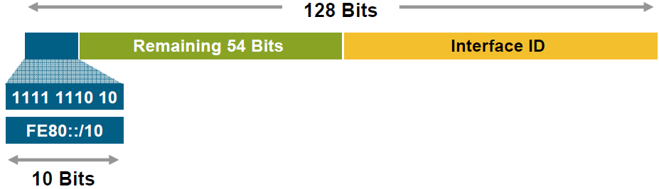
Link-Local Addresses
A link-local address is an IPv6 unicast address that can be automatically configured on any interface using the link-local prefix FE80::/10 (1111 1110 10) and the interface identifier in the modified EUI-64 format.
Link-Local Addresses Used for:
Mandatory address for communication between two IPv6 device
Automatically assigned by router as soon as IPv6 is enabled
Also used for next-hop calculation in routing protocols
Only link-specific scope
Remaining 54 bits could be zero or any manual configured value

Slide 23
Link-Local Addresses
Link-local addresses have a scope limited to the link and are dynamically created on all IPv6 interfaces by using a specific link-local prefix FE80::/10 and a 64-bit interface identifier.
Link-local addresses are used for automatic address configuration, neighbor discovery, and router discovery.
IPv6 routers must not forward packets that have link-local source or destination addresses to other links.
Link-local addresses can serve as a way to connect devices on the same local network without needing global addresses.
When communicating with a link-local address, you must specify the outgoing interface because every interface is connected to FE80::/10.

Slide 24
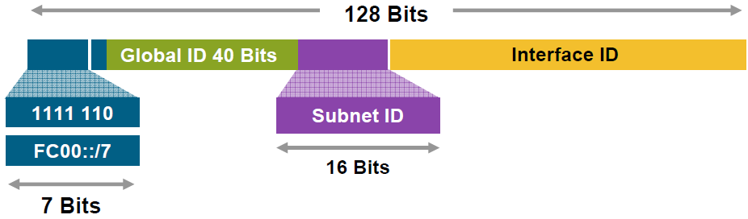
Unique-Local Addresses
Unique-Local Addresses Used for:
Local communications
Inter-site VPNs
Not routable on the Internet

Slide 25
Unique-Local Addresses
A unique local address is an IPv6 unicast address that is globally unique and is intended for local communications.
They are not expected to be routable on the global Internet and are routable inside of a limited area, such as a site. They may also be routed between a limited set of sites.
A unique local address has the following characteristics:
It has a globally unique prefix (that is, it has a high probability of uniqueness).
It has a well-known prefix to allow for easy filtering at site boundaries.
It allows sites to be combined or privately interconnected without creating any address conflicts or requiring renumbering of interfaces that use these prefixes.
It is ISP-independent and can be used for communications inside of a site without having any permanent or intermittent Internet connectivity.
If it is accidentally leaked outside of a site via routing or DNS, there is no conflict with any other addresses.
Applications may treat unique local addresses like global scoped addresses.

Slide 26
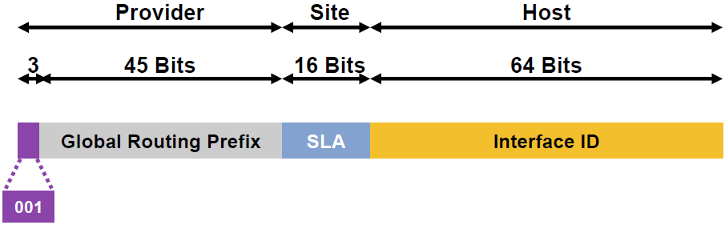
Aggregatable Global Unicast Addresses
Aggregatable Global Unicast Addresses Are:
Addresses for generic use of IPv6
Structured as a hierarchy to keep the aggregation

Slide 27
Aggregatable Global Unicast Addresses
Aggregatable global IPv6 addresses are defined by a global routing prefix, a subnet ID, and an interface ID.
Except for addresses that start with binary 000, all global unicast addresses have a 64-bit interface ID. The IPv6 global unicast address allocation uses the range of addresses that start with binary value 001 (2000::/3).
The Internet Assigned Numbers Authority (IANA) allocates the IPv6 address space in the range of 2000::/16 to regional registries.
A 16-bit subnet field called the subnet ID could be used by individual organizations to create their own local addressing hierarchy and to identify subnets.
A subnet ID is similar to a subnet in IPv4, except that an organization with an IPv6 subnet ID can support up to 65,535 individual subnets.

Slide 28
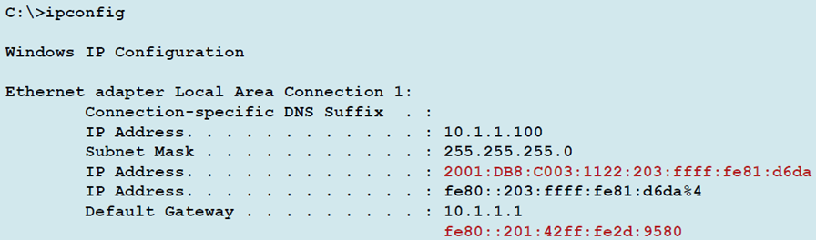
Example & Comments
Aggregatable global unicast addresses
You have to configure it.
Local link addresses
Automatically formed by the OS

Slide 29
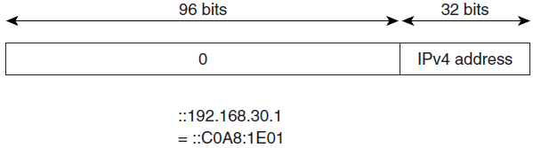
IPv4-Compatible IPv6 Address
An IPv4-compatible IPv6 address is an IPv6 unicast address that has zeros in the high-order 96 bits of the address and an IPv4 address in the low-order 32 bits of the address.
The format of an IPv4-compatible IPv6 address is 0:0:0:0:0:0:A.B.C.D or ::A.B.C.D.
The entire 128-bit IPv4-compatible IPv6 address is used as the IPv6 address of a node and the IPv4 address embedded in the low-order 32 bits is used as the IPv4 address of the node.
IPv4-compatible IPv6 addresses are assigned to nodes that support both the IPv4 and IPv6 protocol stacks and are used in automatic tunnels.

Slide 30
IPv6 Subnet Rule #6
Address type identification
Unspecified 00..0 (128 bits) ::/128
Loopback 00..1 (128 bits) ::1/128
Link Local 1111 1110 10 FE80::/10
Multicast 1111 1111 FF00::/8
Global Unicast everything else
All address types have to support EUI-64 bits Interface ID setting
Except for multicast

Slide 31
IPv6 Loopback & Unspecified Address
Loopback address representation
0:0:0:0:0:0:0:1=> ::1
Same as 127.0.0.1 in IPv4
Identifies self
Unspecified address representation
0:0:0:0:0:0:0:0=> ::
Used as a placeholder when no address available
(Initial DHCP request, Duplicate Address Detection, DAD)

Slide 32
IPv6 Subnet Rule #7 IPv6 Prefixes and Subnet Mask
IPv6 “subnet mask” works the same as IPv4
But only slash notation ‘/’,
No 255.255.255……..
Like v4 address:
198.10.0.0/16
IPv6 address is represented the same way:
2001:db8:12::/48
Prefixes = network ID.
“Host ID” is always 64 bits.

Slide 33
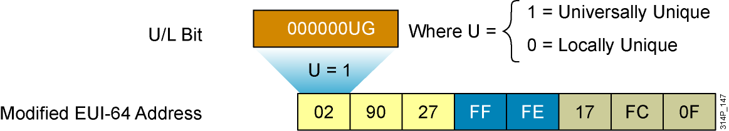
IPv6 Subnet Rule #8 IPv6 EUI-64 Interface Identifier
This format expands the 48-bit MAC address to 64 bits by inserting “FFFE” into the middle 16 bits.
To indicate that the chosen address is from a unique Ethernet MAC address, the U/L bit is set to 1 for global scope (0 for local scope).
Notes:
The 64-bit interface identifier in an IPv6 address identifies a unique interface on a link. A link is a network medium over which network nodes communicate using the data link layer. The interface identifier can also be unique over a broader scope. In many cases, an interface identifier is the same as, or is based on, the data link layer (or MAC) address of an interface. As in IPv4, a subnet prefix in IPv6 is associated with one link.
Interface identifiers in global unicast and other IPv6 address types must be 64 bits long and can be constructed in the 64-bit EUI-64 format. The EUI-64 format interface ID is derived from the 48-bit data link layer (MAC) address by inserting the hexadecimal number FFFE between the upper three bytes (or the Organizational Unique Identifier [OUI] field) and the lower three bytes (or serial number) of the data link layer address. To indicate that the chosen address is from a unique Ethernet MAC address, the seventh bit in the high-order byte is set to 1 (equivalent to the IEEE G/L bit) to indicate the uniqueness of the 48-bit address.
The interface identifier for stateless autoconfiguration in an Ethernet environment uses the modified EUI-64 format. This format expands the 48-bit Ethernet MAC address format to a 64-bit version by inserting "FFFE" in the middle of the 48 bits. This creates a 64-bit version.
The seventh bit (starting with the leftmost bit as “1”) in an IPv6 interface identifier is referred to as the Universal/Local bit, or U/L bit. This bit identifies whether this interface identifier is locally unique on the link or that it is universally unique. In the case where the interface identifier is created from an Ethernet MAC address, it is assumed that the MAC address is universally unique and, therefore, the interface identifier is universally unique.
The rationale of the U/L bit is for future use of the upper-layer protocols to uniquely identify a connection, even in the context of a change in the leftmost part of the address. However, this is not yet used.
The eighth bit (starting with leftmost bit as “1”), also known as the “G” bit, is a group/individual bit for managing groups.

Slide 34
Interface ID
The interface ID is based on the media access control (MAC) address of the interface, in a format called the extended universal identifier 64-bit (EUI-64) format.
The EUI-64 format interface ID is derived from the 48-bit MAC address by inserting the hexadecimal number FFFE between the organizationally unique identifier (OUI) field (the upper three bytes) and the vendor code (the lower three bytes) of the MAC address.
The seventh bit in the first byte of the resulting interface ID, corresponding to the Universal/Local (U/L) bit, is set to binary 1.

Slide 35
Example
The IANA is currently allocating address allocate /32 ranges to ISPs.
For example, an ISP might assign 2001:0:1AB::/48 to an organization.
In a network assigned subnet 5, the prefix would be 2001:0:1AB:5::/64.
On a device with a MAC address 00-0F-66-81-19-A3, the EUI-64 format interface ID would be 020F:66FF:FE81:19A3.
The complete IPv6 global unicast address of the device would therefore be 2001:0:1AB:5:20F: 66FF:FE81:19A3.

Slide 36
IPv6 Subnet Rule #9 How much IPv6?
/0
/64
/128
128 bits
Topological
Interface
Infrastructure
Site
/0
/48
/64
2⁶⁴ “subnet” addresses
= 18,446,744,073,709,551,616
= 18 billion billion subnet addresses
2⁴⁸ site addresses
= 281,474,976,710,656
= 281 thousand billion site addresses

Slide 37
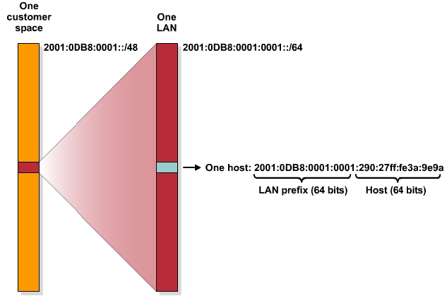
IPv6 Address Allocation Process
Lowest-order 64-bit field of unicast address may be assigned in several different ways:
Autogenerated pseudo-random number (to address privacy concerns)
Assigned via DHCP
Manually configured
Auto-configured from a 64-Bit EUI-64, or expanded from a 48-bit MAC address (e.g., Ethernet address)

Slide 38
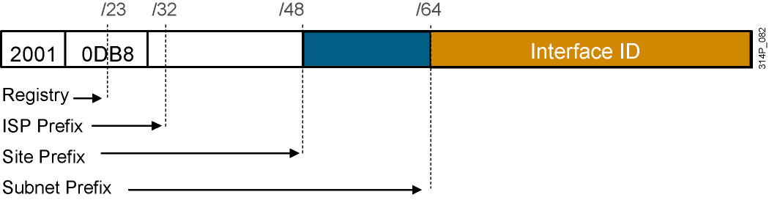
Assigning IPv6 Global Unicast Addresses
Static assignment
Manual interface ID assignment
EUI-64 interface ID assignment
Dynamic assignment
Stateless autoconfiguration
DHCPv6 (stateful)
RouterX(config-if) ipv6 address 2001:DB8:2222:7272::72/64
RouterX(config)# interface ethernet 0
RouterX(config-if)# ipv6 address 2001:0DB8:0:1::/64 eui-64
Notes:
Interface identifiers in IPv6 addresses are used to identify interfaces on a link. They can also be thought of as the “host portion” of an IPv6 address. Interface identifiers are required to be unique on a specific link. Interface identifiers are always 64 bits and can be dynamically derived from a Layer 2 media and encapsulation.
Here are several ways to assign an IPv6 address to a device:
Static assignment using a manual interface ID
Static assignment using an EUI-64 interface ID
Stateless autoconfiguration
DHCP for IPv6 (DHCPv6)
One way to statically assign an IPv6 address to a device is to manually assign both the prefix (or network) and interface ID (or host) portion of the IPv6 address. To configure an IPv6 address on a Cisco router interface and enable IPv6 processing on that interface, use the ipv6 address command in interface configuration mode.
The example shows how to enable IPv6 processing on the interface and configure an address based on the directly specified bits.
Another way to statically assign an IPv6 address is to configure the prefix portion of the IPv6 address and derive the interface ID from the Layer 2 MAC address of the device, known as the EUI-64 interface ID.
To configure an IPv6 address for an interface and enable IPv6 processing on the interface using an EUI-64 interface ID in the low-order 64 bits of the address (or host), use the ipv6 address eui-64 command in interface configuration mode.
The example assigns an IPv6 address to Ethernet interface 0 and uses an EUI-64 interface ID in the low order 64 bits of the address.
Autoconfiguration, as the name implies, is a mechanism that automatically configures the IPv6 address of a node. In IPv6, it is assumed that both PCs and non-PC devices are connected to a network. The autoconfiguration mechanism was introduced to enable plug-and-play networking of these devices and to help reduce administrative overhead.
DHCP for IPv6 enables DHCP servers to pass configuration parameters such as IPv6 network addresses to IPv6 nodes. It automatically allocates reusable network addresses and additional configuration with flexibility. This protocol is a stateful counterpart to IPv6 stateless address autoconfiguration (under RFC 2462), and can be used separately or concurrently with IPv6 stateless address autoconfiguration to obtain configuration parameters.

Slide 39
IPv6 – ISP addressing
Every ISP receives a /32 (or more)
Providing 65,536 site addresses (/48)
/32
/32
/32

Slide 40
IPv6 – Site addressing
Every “site” receives a /48
Providing 65,536 /64 (LAN) addresses
/48

Slide 41
IPv6 – LAN addressing
Every LAN segment receives a /64
Providing 2⁶⁴ interface addresses per LAN
/64

Slide 42
IPv6 – Device addressing
Every device interface receives a /128
May be EUI-64 (derived from interface MAC address), random number (RFC 3041), autoconfiguration, or manual configuration
/128
/128
/128
/128

Slide 43
IPv6 Subnet Rule #10 IPv6 Subnetting
IPv6 subnetting is greatly simplified, compared to IPv4.
An IPv4 site address can be /8 till /24.
A IPv6 site address is always /48
IPv4 subnet bits => variable.
IPv6 subnet bits => 16 bits.
In IPv6 there is no VLSM, classful subnetting, host number design…..
In IPv6 host bits is always 64 bits.
In IPv6 subnet bits is always 16 bits
Subnet #0 to Subnet #65,535

Slide 44
IPv6 Address
Multi-IPv6 Address in single interface
&
Multi-homing

Slide 45
Multi-IPv6 Addresses
A fundamental feature of IPv6 is that a single interface may also have multiple IPv6 addresses of any type (unicast, anycast, and multicast).
An interface can have several addresses, including a link-local address, any global unicast or anycast addresses assigned, a loopback address (::1/128), and any other multicast addresses to which the node is assigned.
In addition, routers must recognize the subnet-router anycast address and the all-routers multicast addresses.

Slide 46
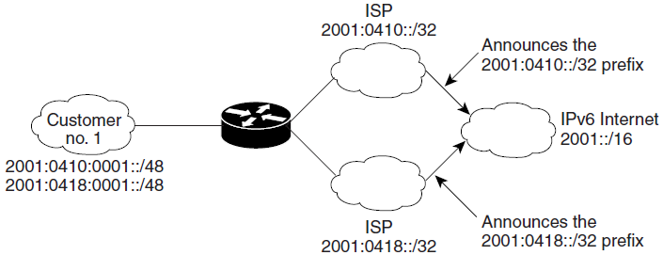
IPv6 Site Multihoming
Multiple IPv6 prefixes can be assigned to networks and hosts.
Having multiple prefixes assigned to a network makes it easy for that network to connect to multiple ISPs without breaking the global routing table

Slide 47
IPv6 Multihoming
Multihoming:
When a network is connected to more than one Internet service provider (ISP)
The chief objective of multihoming
is to increase the quality and robustness of the Internet connection for the IP network.
It is also possible to extend this concept to devices, especially when each of them has more than one interface, and each of the interfaces is attached to different networks.

Slide 48
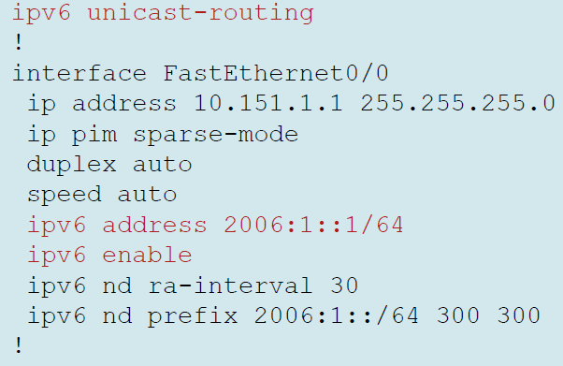
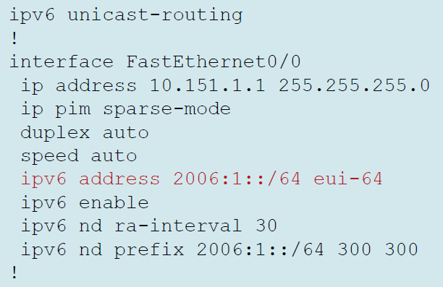
Cisco IPv6 Configuration
Manual Interface Identifier
EUI-64 Interface Identifier

Slide 49
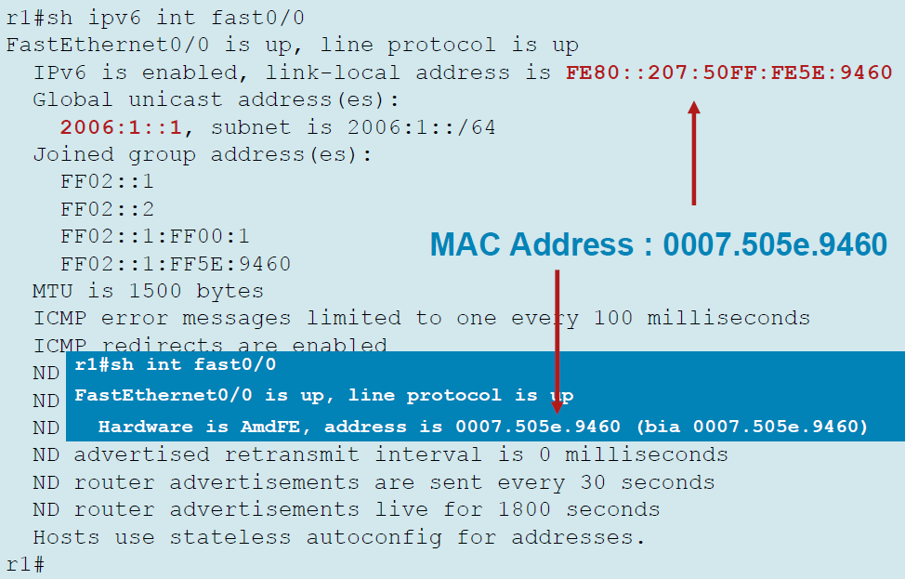
Manual Interface Identifier

Slide 50
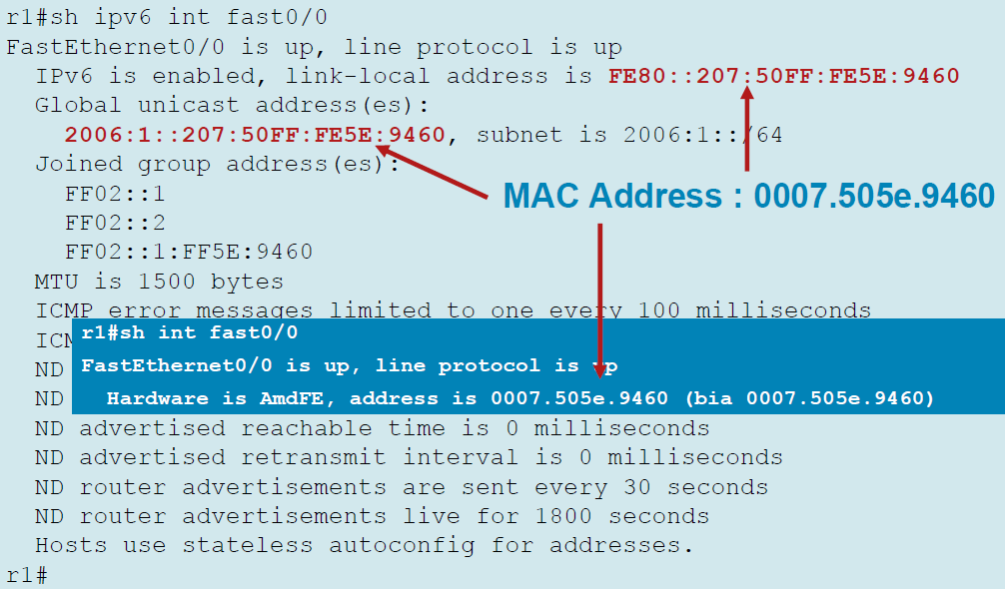
EUI-64 Interface Identifier

Slide 51
Multiple IPv6 Addresses on 1 Interface
You can configure multiple IPv6 addresses onto 1 single interface.
But you can only configure one IPv4 address to a interface
Router(config)#ipv6 unicast
Router(config)#int fa0/0
Router(config-if)#ipv6 enable
Router(config-if)#ipv6 addr 2006:1::1/64
Router(config-if)#ipv6 addr 2006:1::/64 eui-64
Router(config-if)#ipv6 addr 2006:1::1000/64
Router(config-if)#ipv6 addr 2006:1::2002/64
Router(config-if)#no shut
To support
IPv6 multihoming
Router#show ipv6 int br
FastEthernet0/0 [up/down]
FE80::230:A3FF:FE20:201
2006:1::1
2006:1::1000
2006:1::2002
2006:1::230:A3FF:FE20:201
FastEthernet0/1 [administratively down/down]
Vlan1 [administratively down/down]

Slide 52
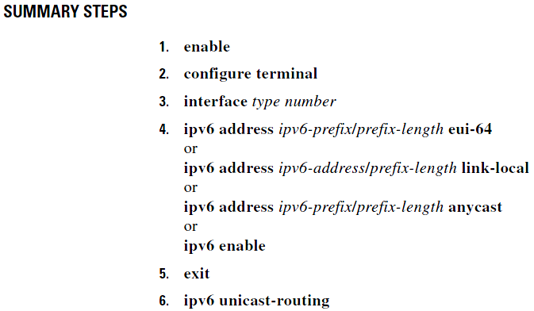
Configuring IPv6 Addressing and Enabling IPv6 Routing

Slide 53
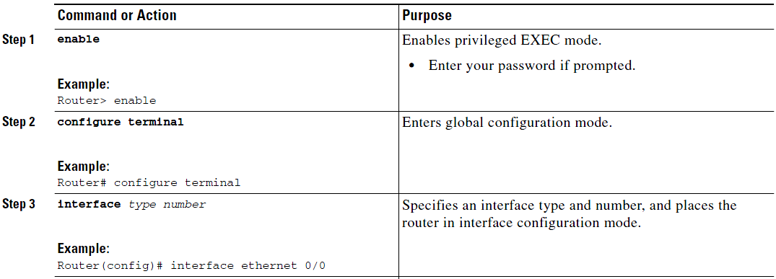
Detail Steps - 1

Slide 54
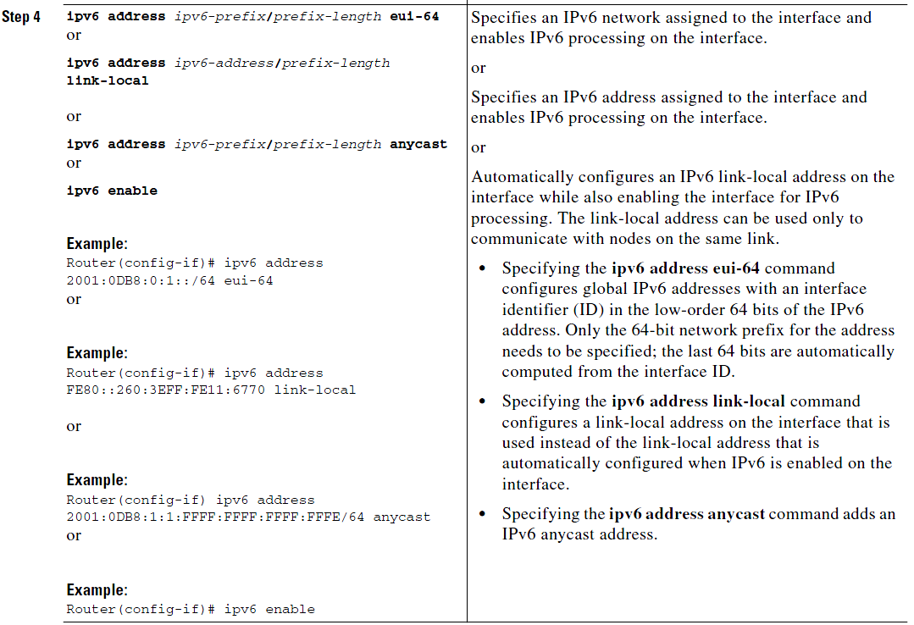
Detail Steps - 2

Slide 55
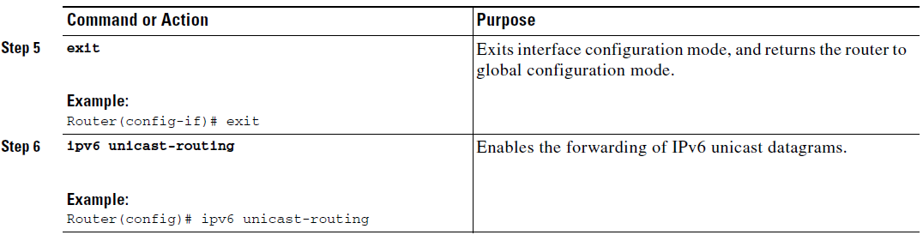
Detail Steps - 2
Note: “ipv6 unicast-routing” command is a MUST for ipv6 to work in Cisco router

Slide 56
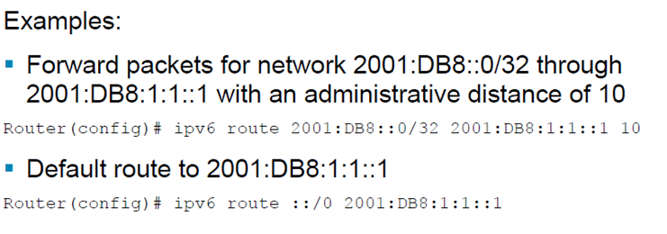
IPv6 Routing: Default and Static Routing
Similar to IPv4. Need to define the next hop/interface.
Default route denoted as ::/0

Slide 57
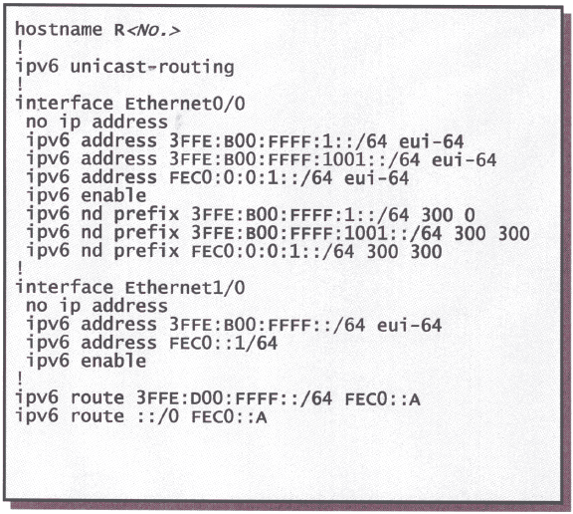
IPv6 Static Route Configuration

